Slide 1
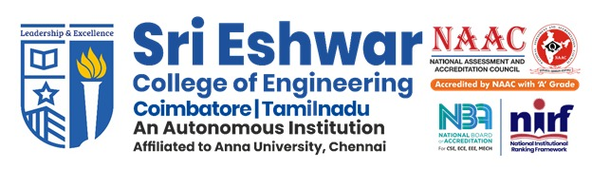
R19AD482 – Project Work-Phase II
TITLE OF THE PROJECT: SmartReport AI Leveraging Multi-Agent Intelligence for Deep Report Analysis, Insight Discovery, and Personalized Recommendations
Domain : Agentic AI

Slide 2
TITLE OF THE PROJECT
TEAM MEMBERS
Pragateesh G - 22AD068
Rudresh J D – 22AD077
Vetrivel A – 22AD119
GUIDED BY
Dr. G.Shobana B.E , M.E , PhD

Slide 3
PROBLEM MOTIVATION
Users receive complex reports across multiple domains such as healthcare, finance, and education, which are difficult to interpret manually.
There is a clear challenge in identifying critical information and actionable insights from these reports.
Most existing document analysis systems are limited to a single domain, reducing their flexibility and usability.
The project addresses the need for a domain-agnostic AI system rather than domain-specific solutions.
It proposes a multi-agent AI architecture to automatically classify documents, analyze content, and extract key insights using NLP and semantic understanding.
The solution leverages OCR, vector databases, and contextual language models to support multiple document formats and ensure adaptable, software-based analysis.

Slide 4
PROBLEM DEFINITION
Users face difficulty in understanding and interpreting complex reports from different domains such as healthcare, finance, and education.
Manual analysis of reports is time-consuming and error-prone, especially for non-expert users.
Existing AI solutions are mostly domain-specific or enterprise-focused, limiting their usability for common users.
There is no unified system to automatically classify documents and extract meaningful insights across multiple domains.
Users lack access to tools that provide actionable recommendations from reports in a simple and user-friendly manner.

Slide 5
OBJECTIVE
To develop a domain-agnostic AI system capable of analyzing documents from multiple fields such as healthcare, finance, education, and legal.
To automatically classify documents and extract key insights using NLP and semantic understanding.
To design a multi-agent architecture that performs document analysis, insight generation, and recommendation delivery efficiently.
To support multiple document formats (PDFs, scanned files, images) using OCR and vector-based semantic retrieval.
To provide clear, actionable recommendations through a simple and user-friendly interface for everyday users.

Slide 6
EXISTING SYSTEM
FinVerse – Automates financial analysis with multi-agent LLMs and real-time data APIs; powerful for finance but not domain-agnostic.
FinCon – Uses hierarchical multi-agent roles with memory and reinforcement; modular design makes it adaptable beyond finance.
Enhancing Anomaly Detection – Employs specialized agents for data conversion, consolidation, and validation; accurate but narrowly focused on anomaly detection.
LLM-MedQA – Provides clinical reasoning with case generation, voting, and explanation; transparent but not suitable for full document analysis or multi-domain insights.

Slide 7
DISADVANTAGES OF EXISTING SYSTEM
FinVerse – Designed specifically for financial analysis, making it unsuitable for documents from other domains such as healthcare or education.
FinCon – Although modular, it is primarily finance-oriented and involves complex agent hierarchies, limiting its practicality for simple, everyday document analysis.
Enhancing Anomaly Detection – Focuses only on detecting anomalies, lacking full document understanding, insight generation, and cross-domain adaptability.
LLM-MedQA – Restricted to the medical domain and question–answering tasks, and does not support comprehensive document analysis or multi-domain insight extraction.

Slide 8
PROPOSED SYSTEM
A domain-agnostic multi-agent LLM framework capable of analyzing documents across diverse fields such as finance, healthcare, legal, and academia.
Supports both structured and unstructured data, enabling comprehensive analysis of full-length documents.
Utilizes modular, role-based agents for document ingestion, summarization, critical analysis, recommendation generation, and result verification.
Integrates self-critique and cross-agent collaboration to improve reliability, transparency, and reasoning quality.
Provides actionable insights and personalized recommendations without requiring architectural changes for new domains.

Slide 9
ADVANTAGES OF PROPOSED SYSTEM
Domain-agnostic design enables analysis of documents from multiple fields without redesign or reconfiguration.
Multi-agent architecture improves accuracy by dividing tasks such as classification, insight extraction, and recommendation generation.
Supports both structured and unstructured documents, including PDFs and scanned files, using OCR and NLP.
Provides clear, actionable insights and recommendations, not just raw analysis or summaries.
Lightweight and user-friendly, making it suitable for everyday users rather than only enterprise environments.
Ensures scalability and adaptability, allowing easy extension to new domains and document types.

Slide 10
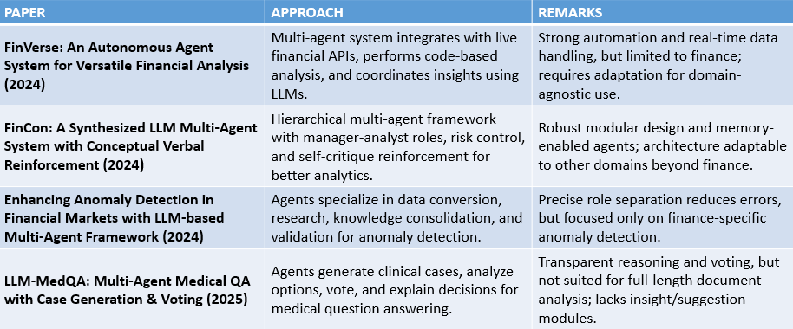
LITERATURE SURVEY

Slide 11
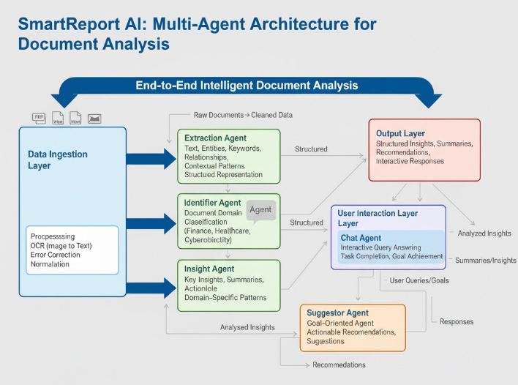
SYSTEM ARCHITECTURE

Slide 12
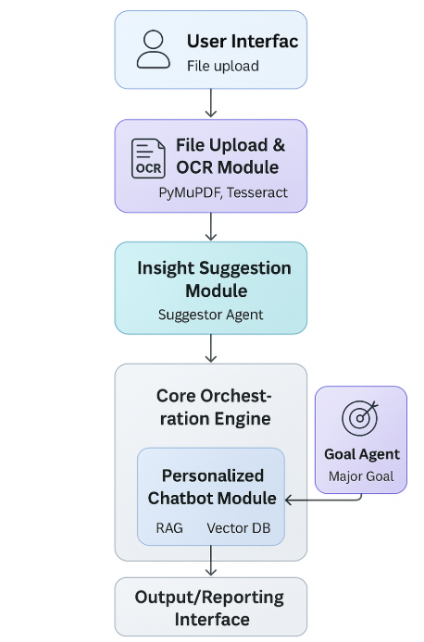
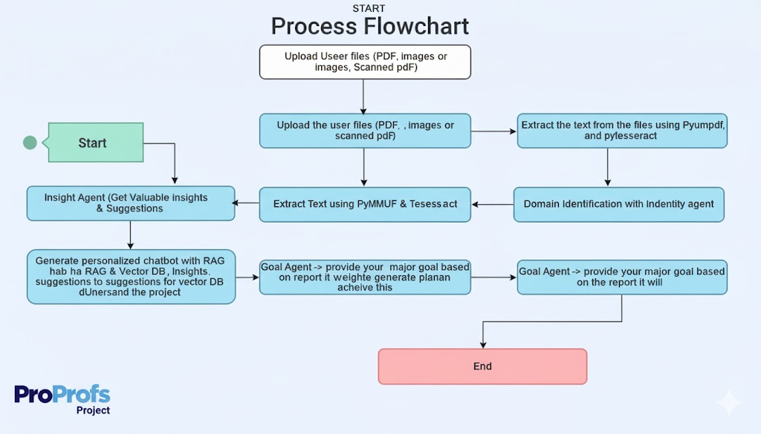


DATA FLOW DIAGRAM

Slide 13
MODULES
User Interface Module
Document Ingestion & OCR Module
Domain Identification Module
Insight Extraction Module
Recommendation Generation Module
Goal-Specified Agent Module
Vector Database & Semantic Retrieval Module
Chatbot Interaction Module
Agent Orchestration & Backend Module

Slide 14
MODULE DESCRIPTION
User Interface Module – Provides a simple interface for users to upload documents and view insights and recommendations.
Document Ingestion & OCR Module – Extracts text from PDFs, scanned documents, and images using OCR and parsing techniques.
Domain Identification Module – Automatically identifies the domain of the document such as healthcare, finance, or education.
Insight Extraction Module – Analyzes document content using NLP to extract important information and key findings.

Slide 15
MODULE DESCRIPTION
Recommendation Generation Module – Generates actionable and personalized suggestions based on extracted insights.
Goal-Specified Agent Module – Aligns insights and recommendations with specific user-defined goals.
Vector Database & Semantic Retrieval Module – Stores embeddings and enables fast semantic search for context-aware retrieval.
Chatbot Interaction Module – Allows users to interact with documents and insights through natural language queries.
Agent Orchestration & Backend Module – Manages coordination between all agents and controls system workflow.

Slide 16
CONCLUSION
SmartReport AI successfully demonstrates the effectiveness of a domain-agnostic, AI-powered multi-agent system for analyzing short, multi-domain documents and transforming complex information into meaningful insights. By integrating OCR, NLP, vector-based semantic retrieval, and role-based agents, the system enables automatic document classification, insight extraction, and recommendation generation across diverse domains. The project focuses on simplicity, usability, and cross-domain adaptability, making it suitable for everyday users rather than enterprise-only environments. Overall, SmartReport AI provides a scalable and practical solution that simplifies document understanding and supports informed decision-making in real-world scenarios.

Slide 17
REFERENCES
Li, J., Xu, Z., Wang, Y., & Zhang, M. — FinVerse: An Autonomous Agent System for Versatile Financial Analysis
Luo, Q., Zhang, Z., & Sun, Y. — FinCon: A Synthesized LLM Multi-Agent System with Conceptual Verbal Reinforcement
Sharma, A., & Gupta, R. — Enhancing Anomaly Detection in Financial Markets with LLM-based Multi-Agent Framework
Zhang, H., Chen, L., & Wang, Q. — LLM-MedQA: Multi-Agent Medical QA with Case Generation & Voting
He, X., Wu, D., Zhai, Y., & Sun, K. — SentinelAgent: Graph-based Anomaly Detection in Multi-Agent Systems
Xiao, Y., et al. — TradingAgents: A Multi-Agents LLM Financial Trading Framework
Ji, X., et al. — LEMAD: LLM-Empowered Multi-Agent System for Anomaly Detection

Slide 18


